Slide 1
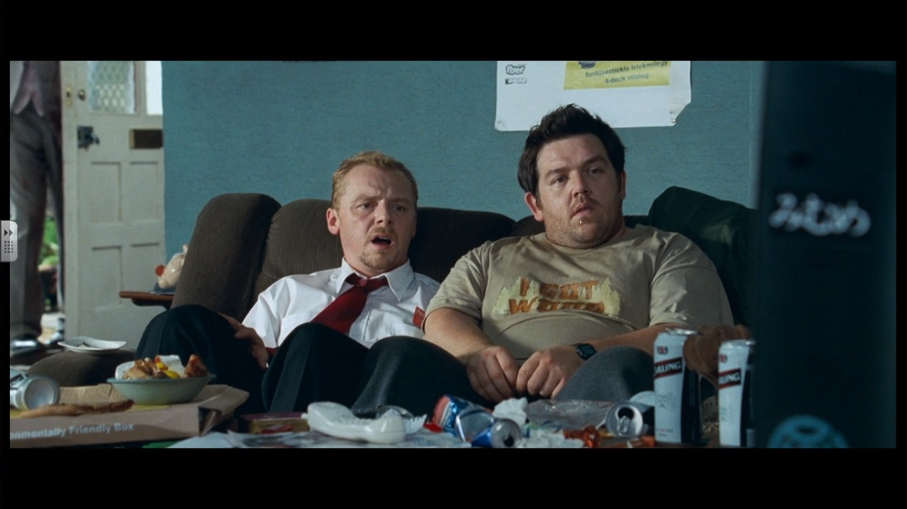
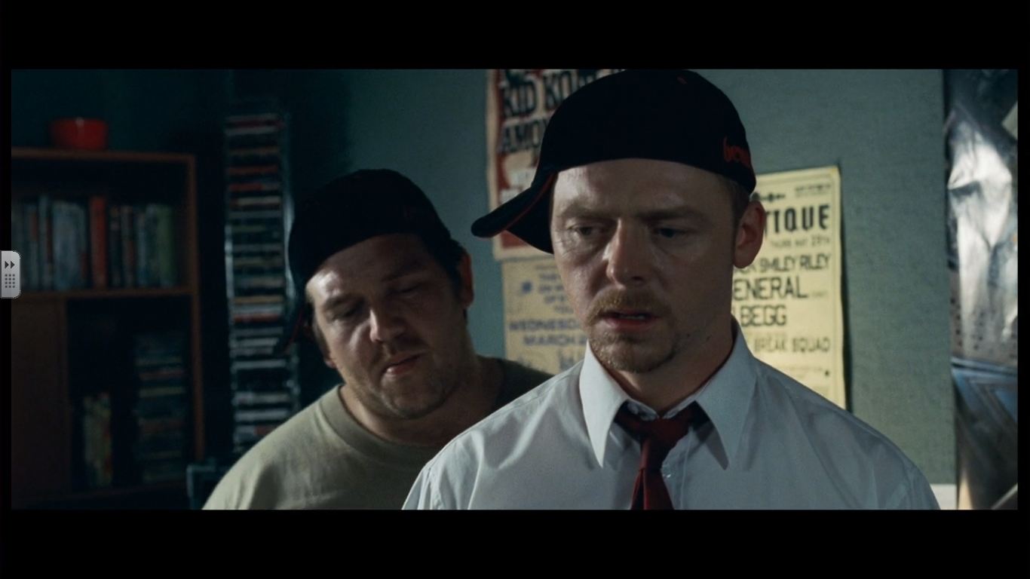
Closer Analysis - Complete your worksheet. Think conceptually rather than practically.
During a time of crisis our central characters decide to sit down and watch tv. Representing Wright’s theory on a clueless/ Slacker generation.
Medium shot-
Scene clearly demonstrates the characters lifestyle.
Characters are 30 something in a student infected adolescence surrounded by sweet wrappers, cans and soft drinks.
The platform of this film is based around repeated motifs and lines.
Here we are shown a repeated motif of Shaun and Ed leaving the door open. Representation- adolescent/ Peter pan characters.
1st door reference:
24:30

Slide 2
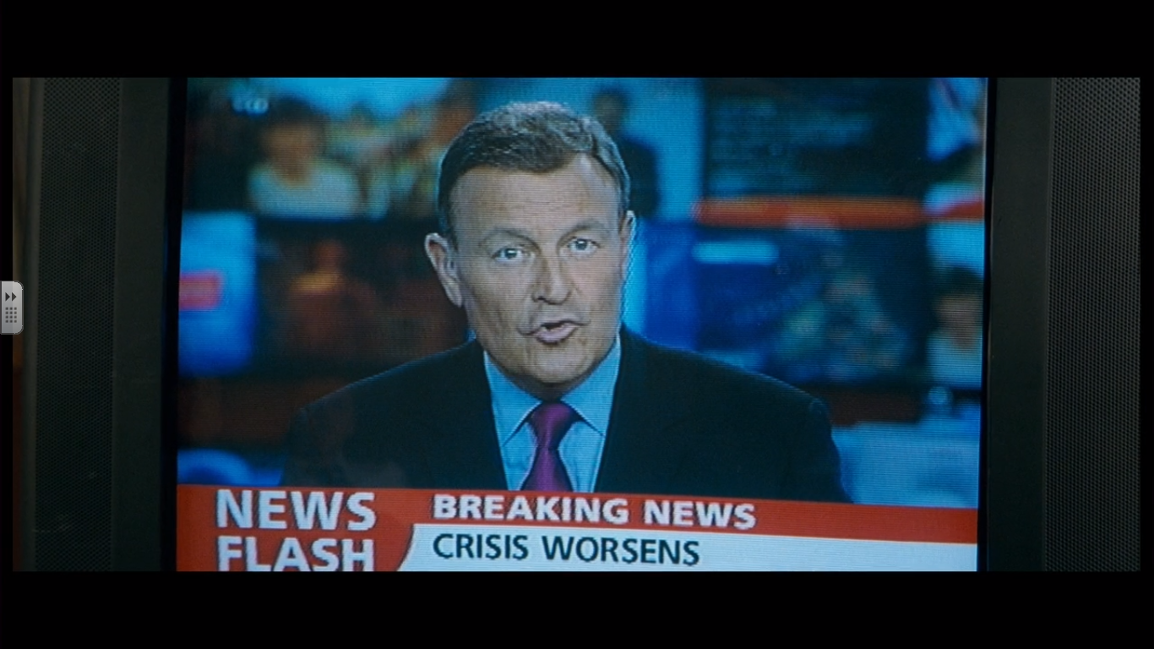

Slide 3
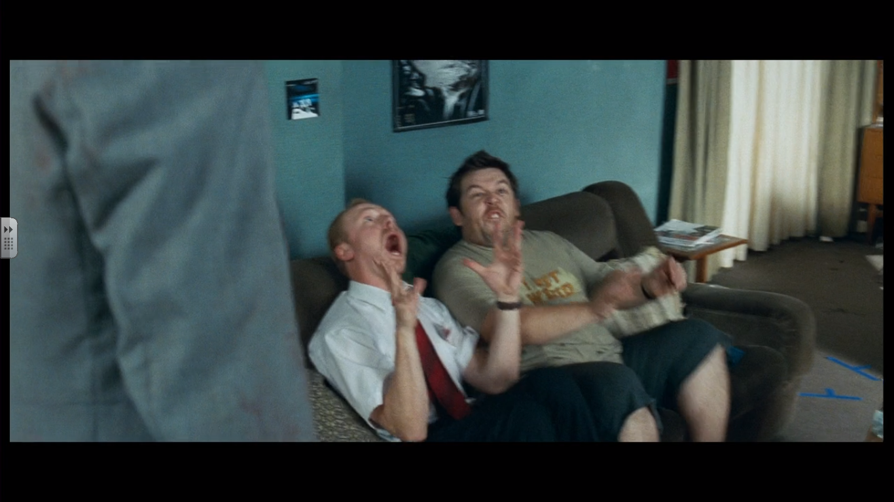

Slide 4
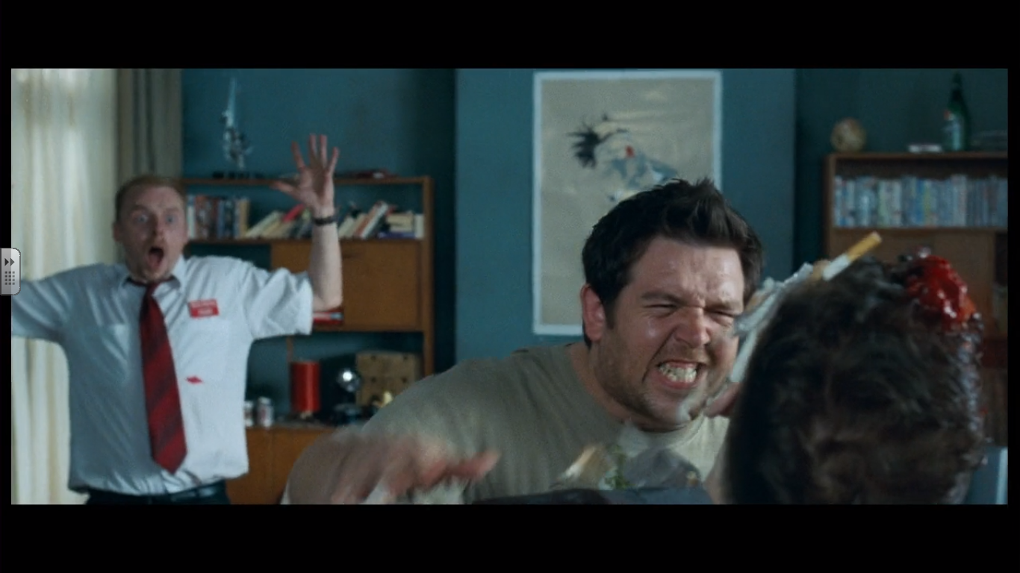

Slide 5
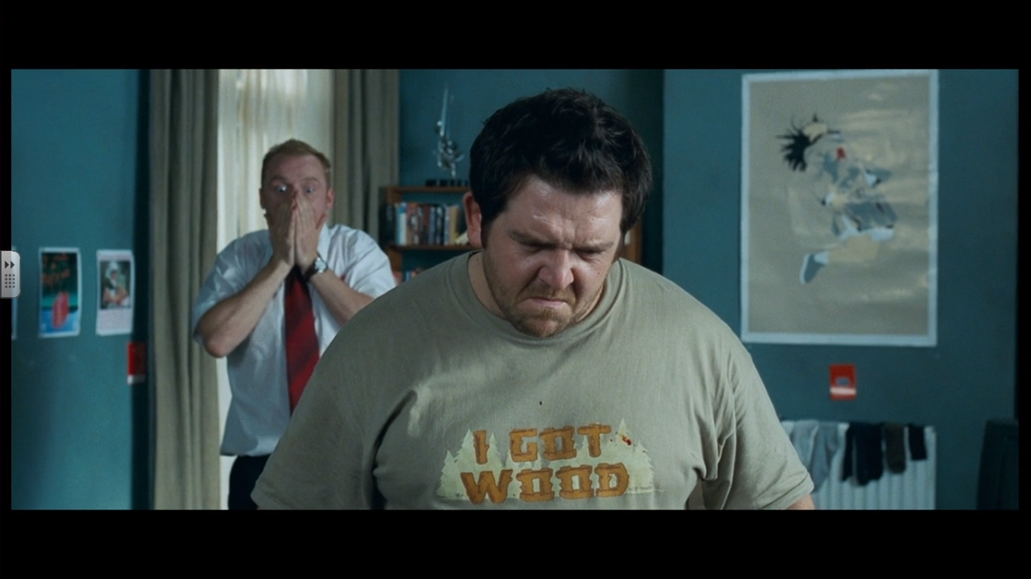

Slide 6
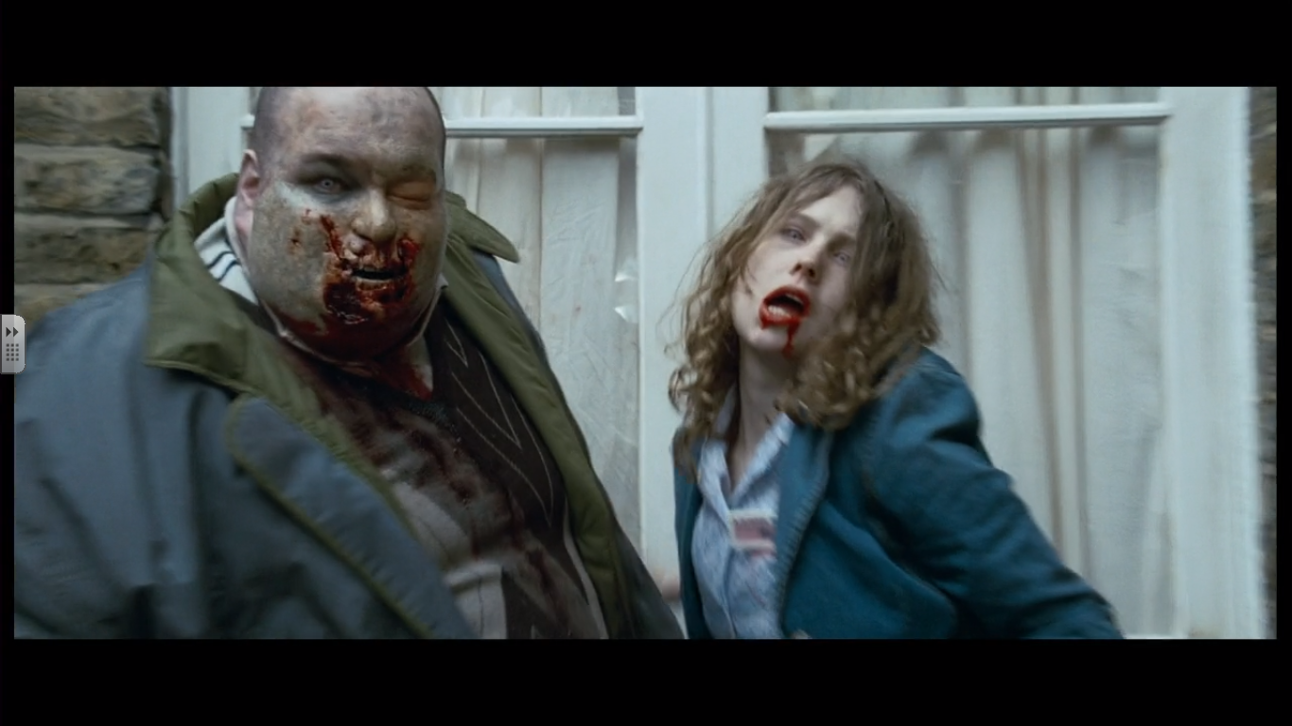

Slide 7
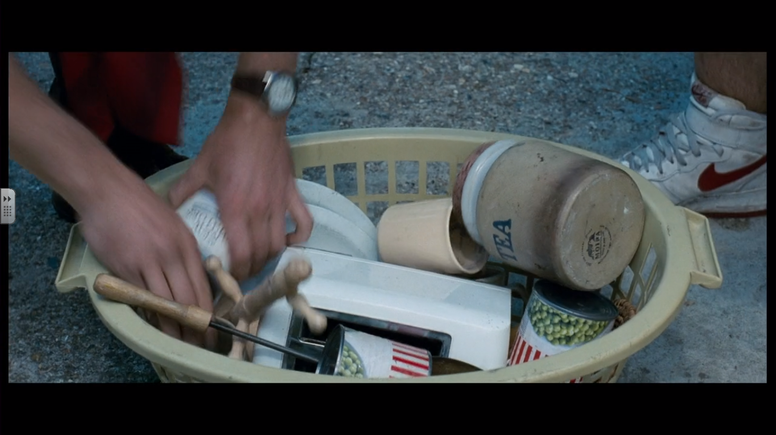

Slide 8
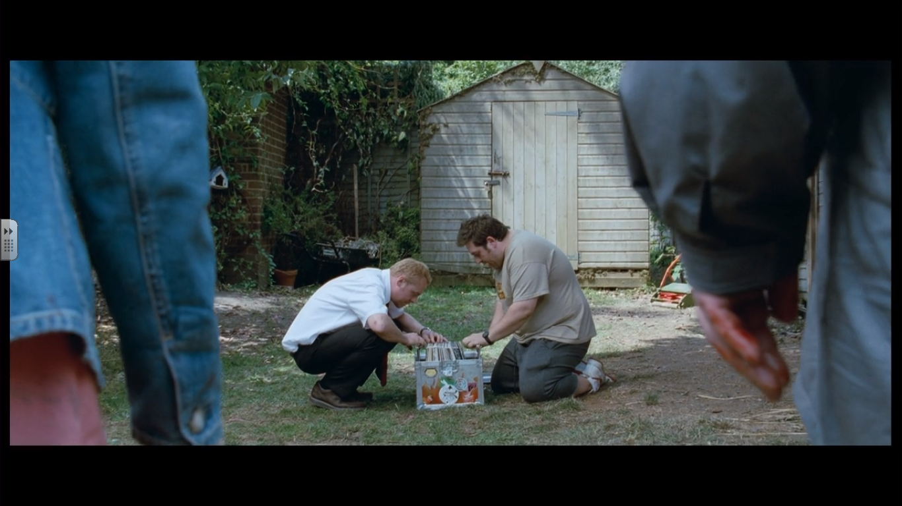

Slide 9
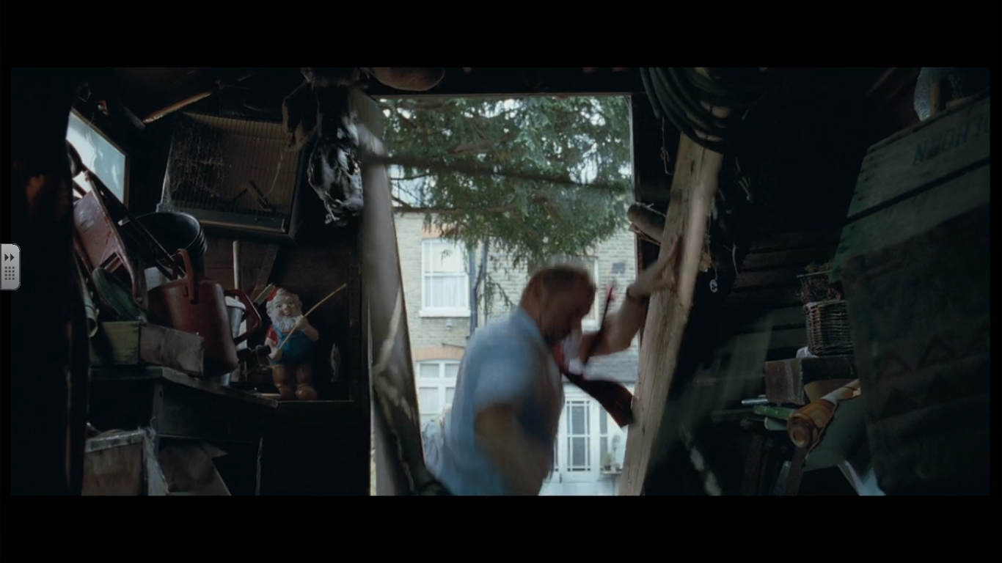

Slide 10
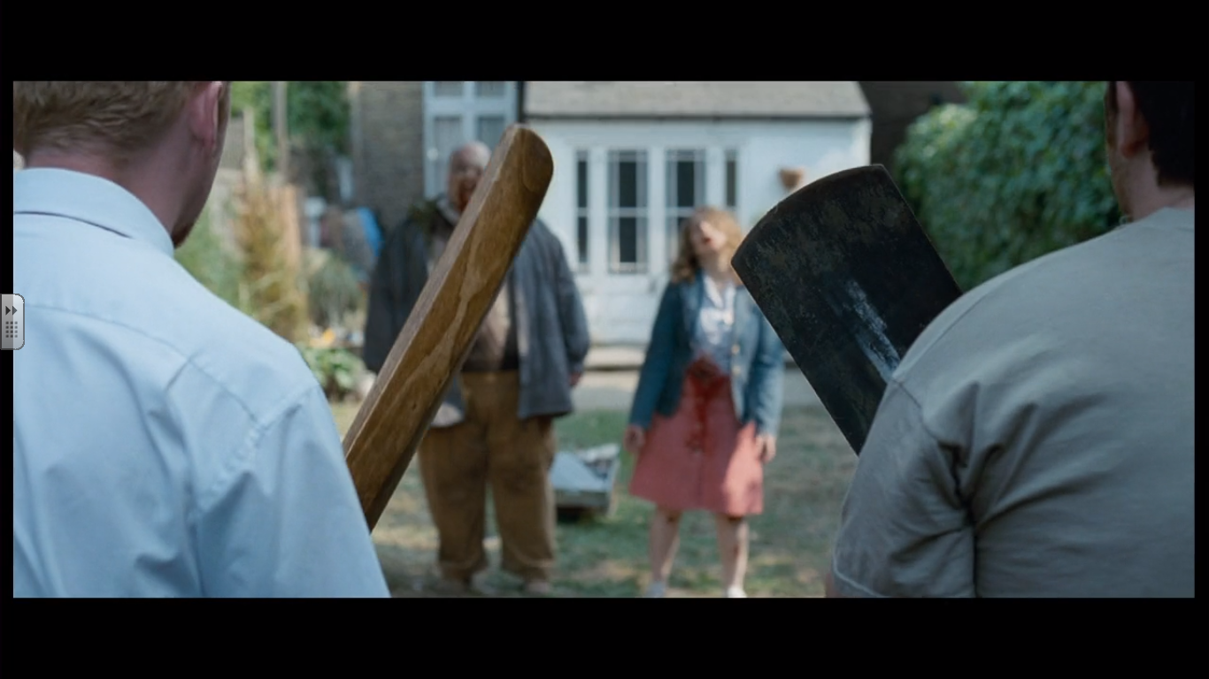
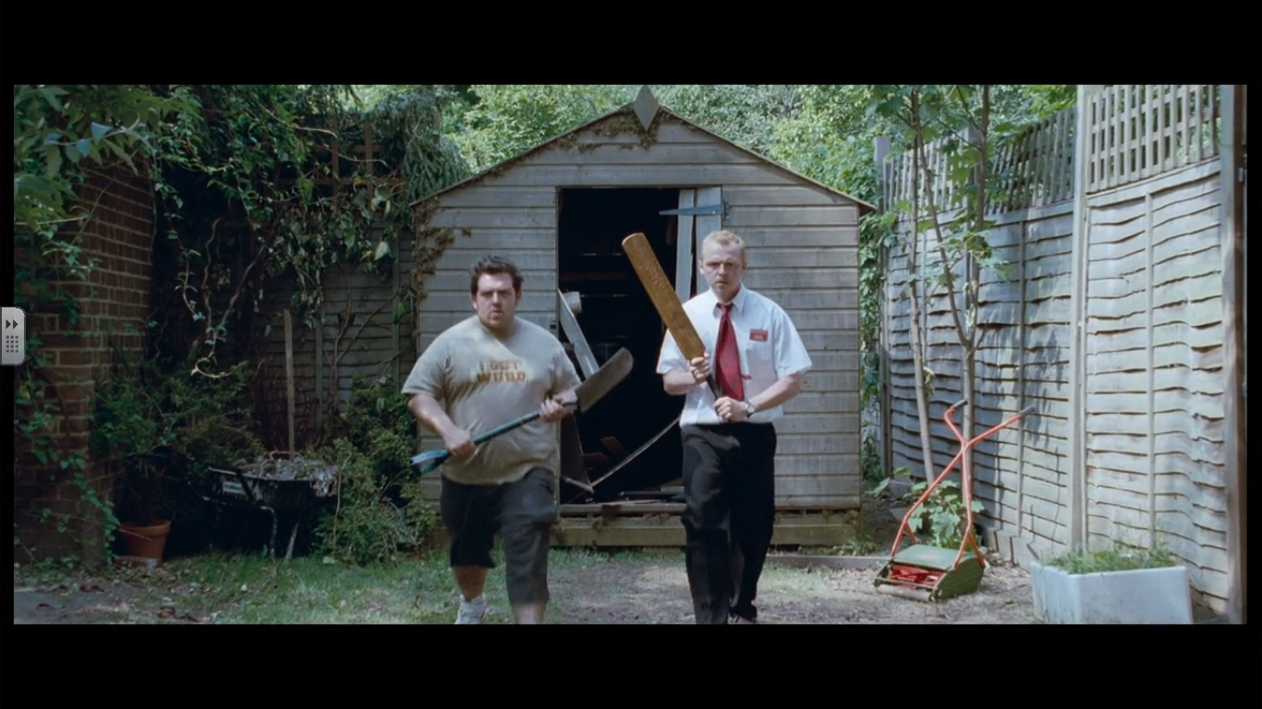

Slide 11
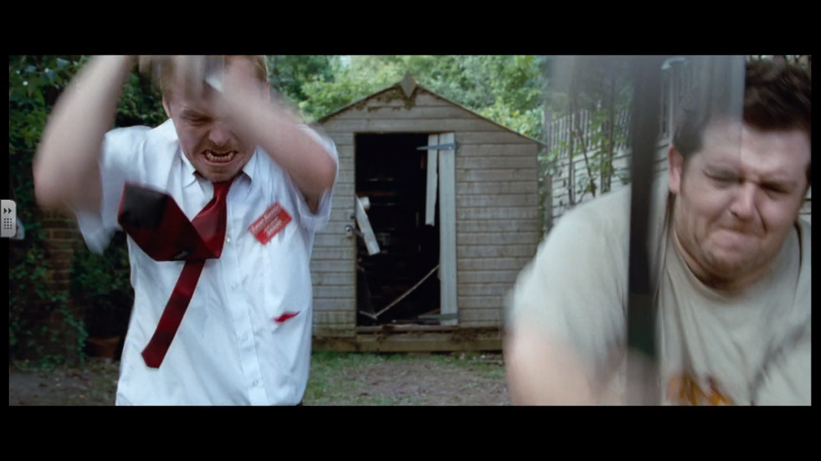

Slide 12
