Slide 1
Useful Sequences
Shaun of the Dead
(2004, Wright)

Slide 2
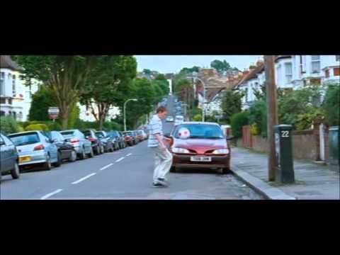
Opening Sequence

Slide 3
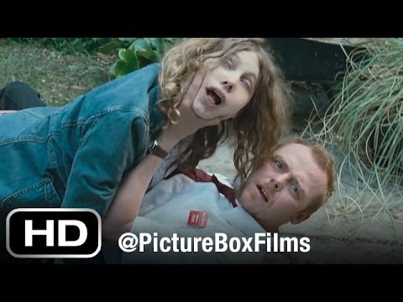
There’s a girl in the garden

Slide 4
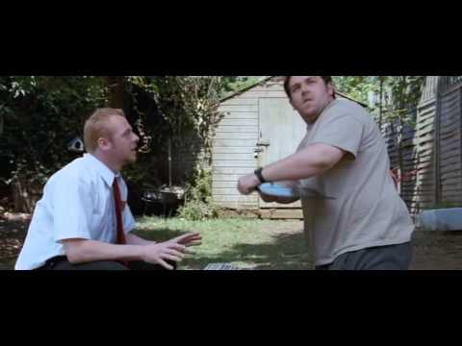
Record Scene

Slide 5
Ed’s visual foreshadowing

Slide 6
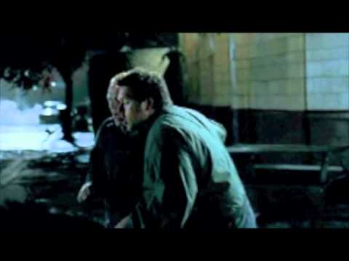
Shaun and Ed walk back to their flat

Slide 7
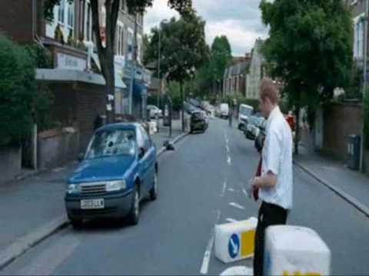
Shaun walks to the shops #1

Slide 8
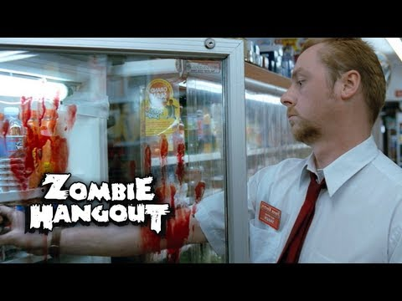
Shaun walks to the shops #2

Slide 9
News Headlines

Slide 10
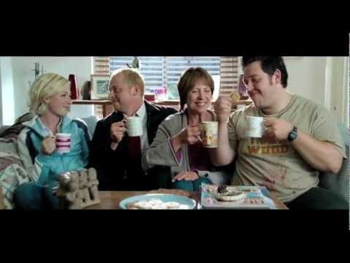
The Plans

Slide 11
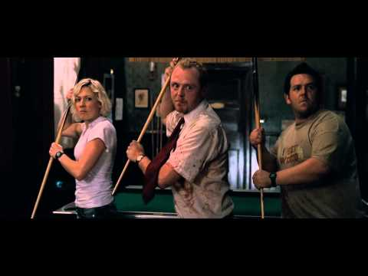
Don’t stop me now

Slide 12
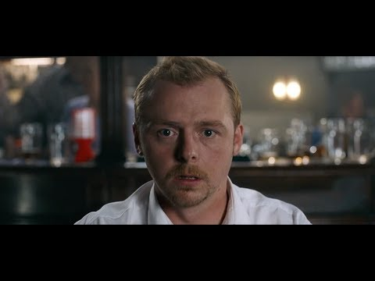
Visual Comedy

Slide 13
Trailer

